Slide 1
Going public with Infura
Chapter 8

Slide 2
Plan for the rest of the semester
Finish chapter 8 to learn working on public deployment: Part of Phase 3 of your project.
I would like to work on Chapter 9 and 10 in the next weeks, possible Ch 11 too!
Final exam review on 5/19 (Just a reminder).

Slide 3
Possible projects!
1. I need people interested in working on DeFi research. – This is my only summer project unless the another project gets renewed.
2. I am looking for coders and developers with no hesitation about front-end-webs—smart contract development.
3. Extending MPC:
I want to extend MPC for multiple channels and multiple workers: currently the channel operates ONLY for one worker!
Also I want to add a layer above for “Governance” and ”Decentralized Autonomous Organization” (DAO)
I want form a TEAM MPC: are you interested!

Slide 4
7.4.9 Extensions of MPC
Unlike the digital democracy (Ballot in chapter 4), marketplace (ASK in chapter 6),
and online auction (blind auction in chapter 6) models, the micropayment channel
model you learned in this chapter cannot be solved by traditional methods.
I am sure you are wondering whether the smart contract for MPC can be kept open instead of
self-destructing after a single claim. The smart contract for MPC can be extended to
handle other conditions and situations, such as
○ Time duration-based channels
○ Worker not claiming the payment within a certain time
○ Extending the channel instead of closing it
○ Premature closure of the channel by the organizer
○ Inclusion of other items, such as nonce, in the message of the micropayment
○ Bidirectional payments
○ One-to-many channels
○ Other application-dependent criteria: Governance and DAO
Consider all these for your project, phase 2.

Slide 5
Events and logs
FinalExam
Explore the concepts of events;
Use events in your project phase 2
Events are built on top of a lower level log interface in Ethereum. Although you typically won’t deal with log messages directly, it’s important to understand their limitations.
Logs are structured as up to four “topics” and a “data” field. The first topic is used to store the hash of the event’s signature, which leaves only three topics for indexed parameters. Topics are required to be 32 bytes long, so if you use an array for an indexed parameter (including types string and bytes), the value will first be hashed to fit into 32 bytes. Non-indexed parameters are stored in the data field and do not have a size limit.
Logs, and therefore events, are not accessible from within the Ethereum virtual machine (EVM). This means that contracts cannot read their own logs or the logs of other contracts.
It is technically sound programming element in the context of blockchain. Liked by technologists.

Slide 6
To do for today
We’ll learn the basics of public deployment and then learn to deploy on Infura.

Slide 7
Chapter 8
This chapter covers
○ Exploring Ethereum nodes and network infrastructure
○ Understanding services offered by infrastructure provider Infura
○ Defining a roadmap for deploying a Dapp on a public network
○ Deploying Dapps on Infura nodes and the Goerli network
○ Working with multiple decentralized participants

Slide 8
What is infura?
Blockchain is fundamentally a public infrastructure, like a highway or a road.
Up to this point, you’ve been using the Ganache test chain (Ganache on localhost:7545) to deploy your applications, which is like learning to drive in a parking lot or prototyping an experiment in a lab.
Now let’s move to the public roads to practice the Dapp development skills you’ve learned. To drive on the public roads, you don’t build the roads yourself; you use the existing infrastructure.
Similarly, to deploy on a public blockchain, you’ll need public infrastructure support, similar to cloud services. I’ll introduce Infura (https://infura.io), a cloudlike service for hosting blockchain nodes.
Infura also provides a gateway to public networks such as Goerli as well as to IPFS.
I found out (through an unexpected 2021 Ethereum crash) many ERC20/cryptocurrencies (e.g. Binance) are deployed on Infura!

Slide 9
Why Infura? Isn’t centralized?
You can run a blockchain node yourself, not for mining or validating, but for storing the DLT of the blockchain for analysis/downstream applications. – that is quite intensive.
Infura is a cloud like service that allows for you to host nodes for your project.
You can deploy your project’s smart contracts on Infura free level and keep improving on it, make it a real thing!
There is a free level and paid level.
I use the free level for my prototyping.
You can now create an account: sign up for the service! Do that now: That will help with your project phase 3.

Slide 10
Nodes and Network
Infura: it is a secure, production-ready, scalable infrastructure to support your blockchain nodes in place of your prototype local environment (such as Remix and Ganache).
It provides the nodes and API to access Ethereum networks. Let’s learn to use the nodes and networks offered by Infura.
Execution layer
Protocol layer

Slide 11
Infura blockchain infrastructure
Let’s all get an account on Infura:
It is free for three projects,
and limited requests/day

Slide 12
Create a “free” account on Infura
https://infura.io/
This was the older front page
For Infura.

Slide 13
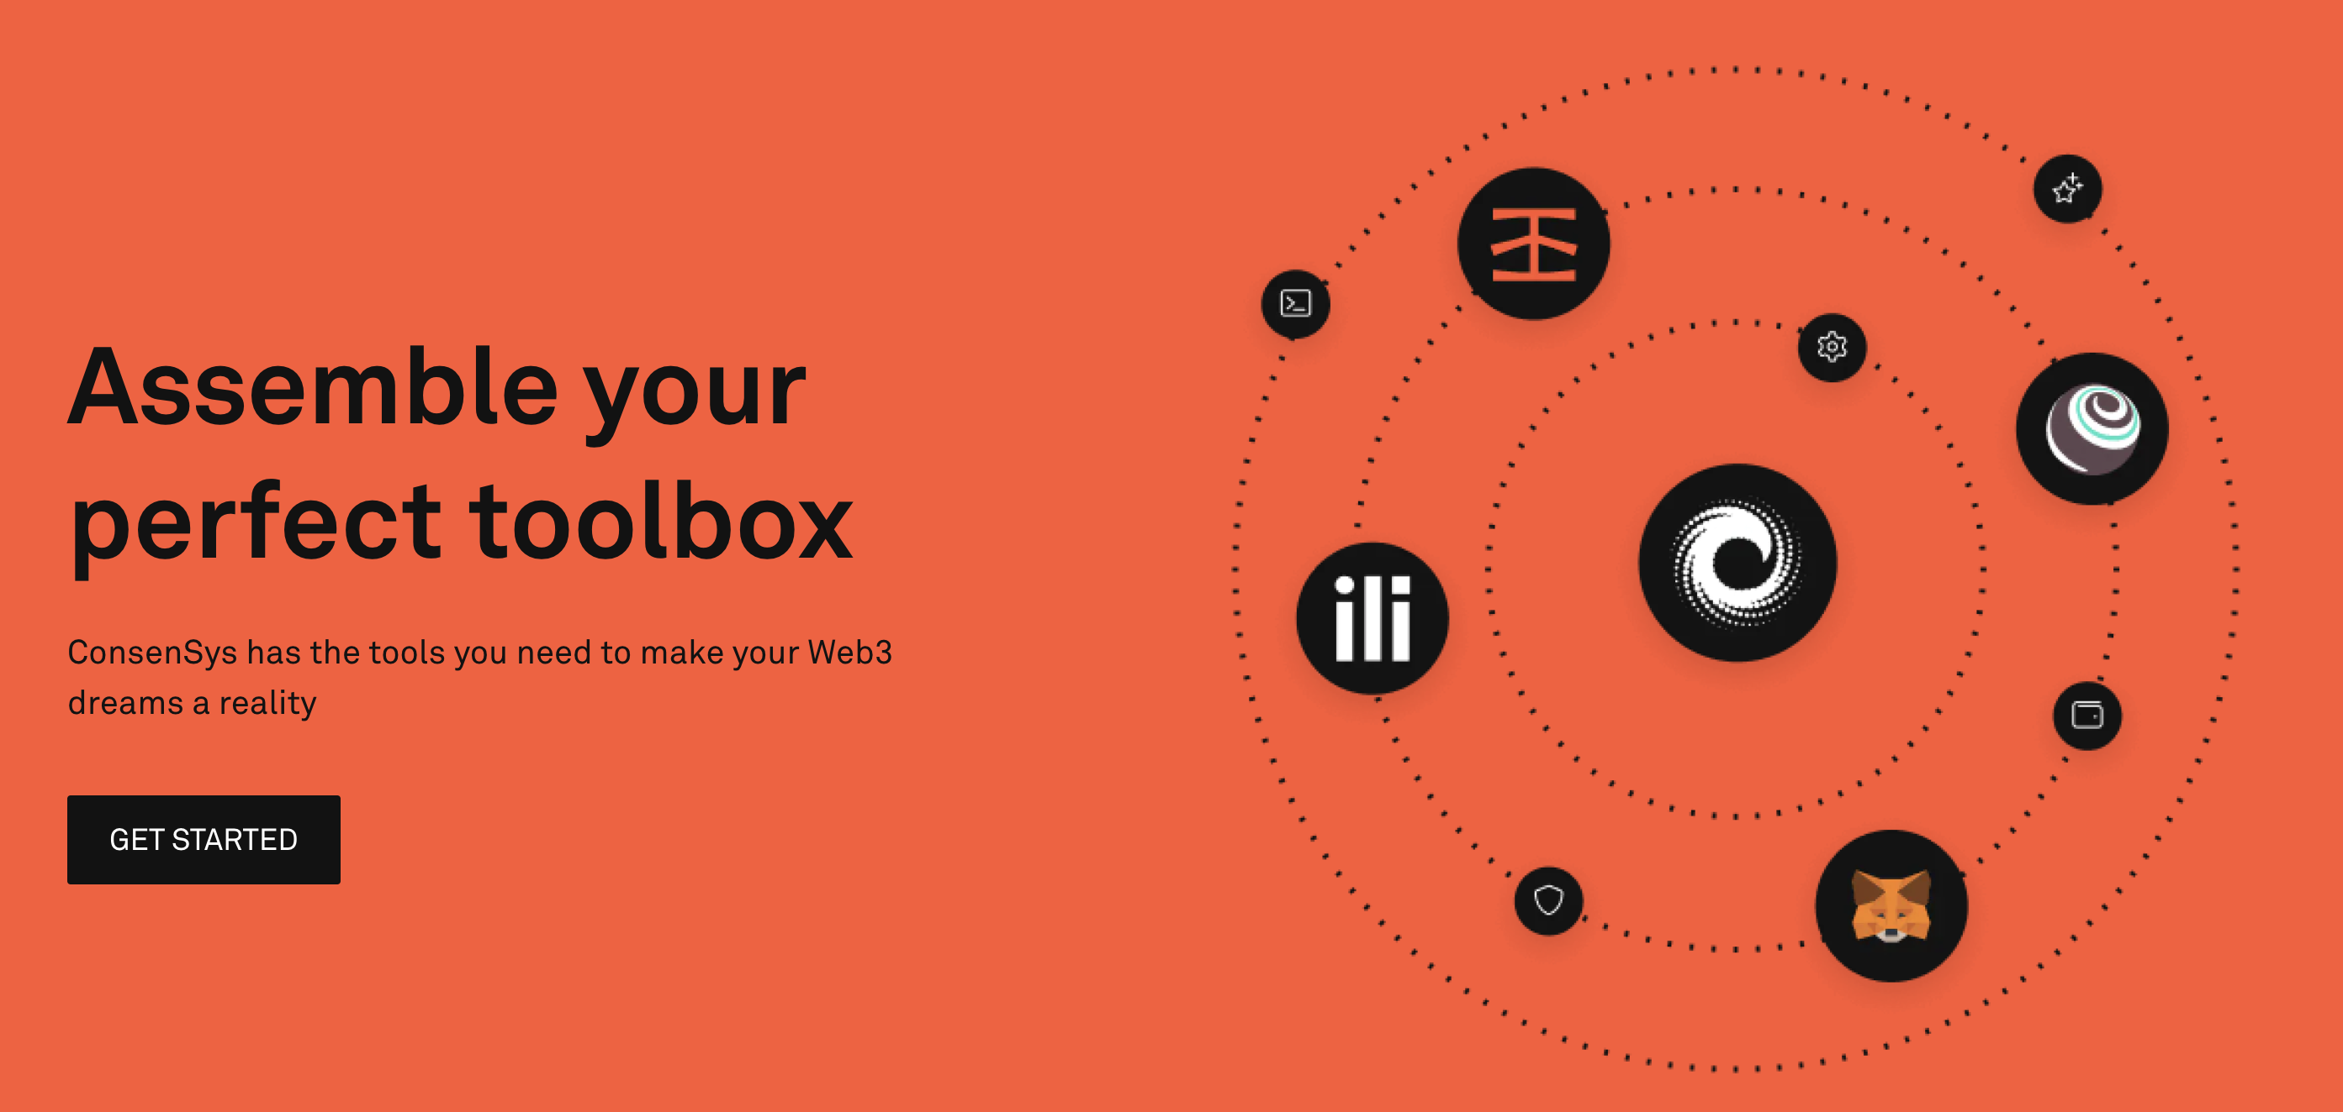
Here is the new Infura front-end from Consensys.
Let’s see if we can identify the tools.

Slide 14
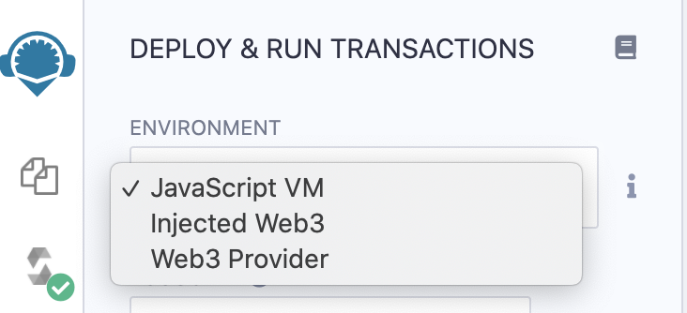
Blockchain node as a service
Infura is a cloudlike infrastructure that enables the Ethereum node as a service.
It also facilitates linking with many public networks, such as the mainnet (using real ether), Goerli, and Rinkeby (using test ether);
and provides a gateway for IPFS, a decentralized file system.
It offers an easy-to-use dashboard for creating Ethereum projects for deploying smart contracts, configuring security settings for projects, and selecting the public network to connect to.
It can be the web3 provider in the Remix dropdown…
So you can have Remix connect to Infura! Try this.

Slide 15
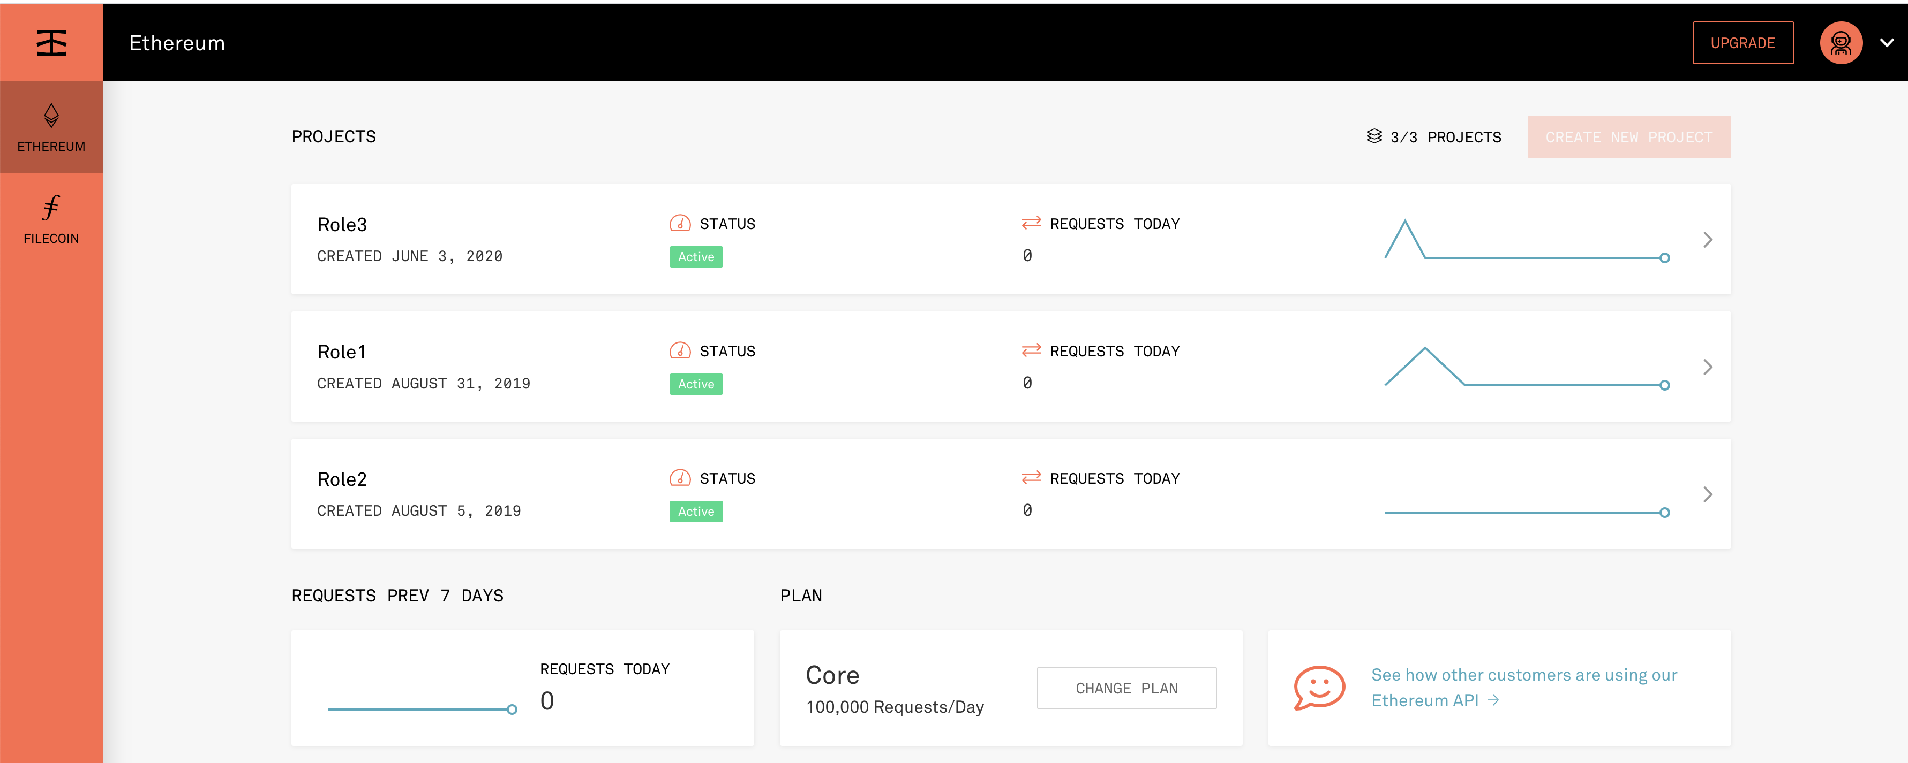
Explore! It is a cool stuff.
My old interface.

Slide 16
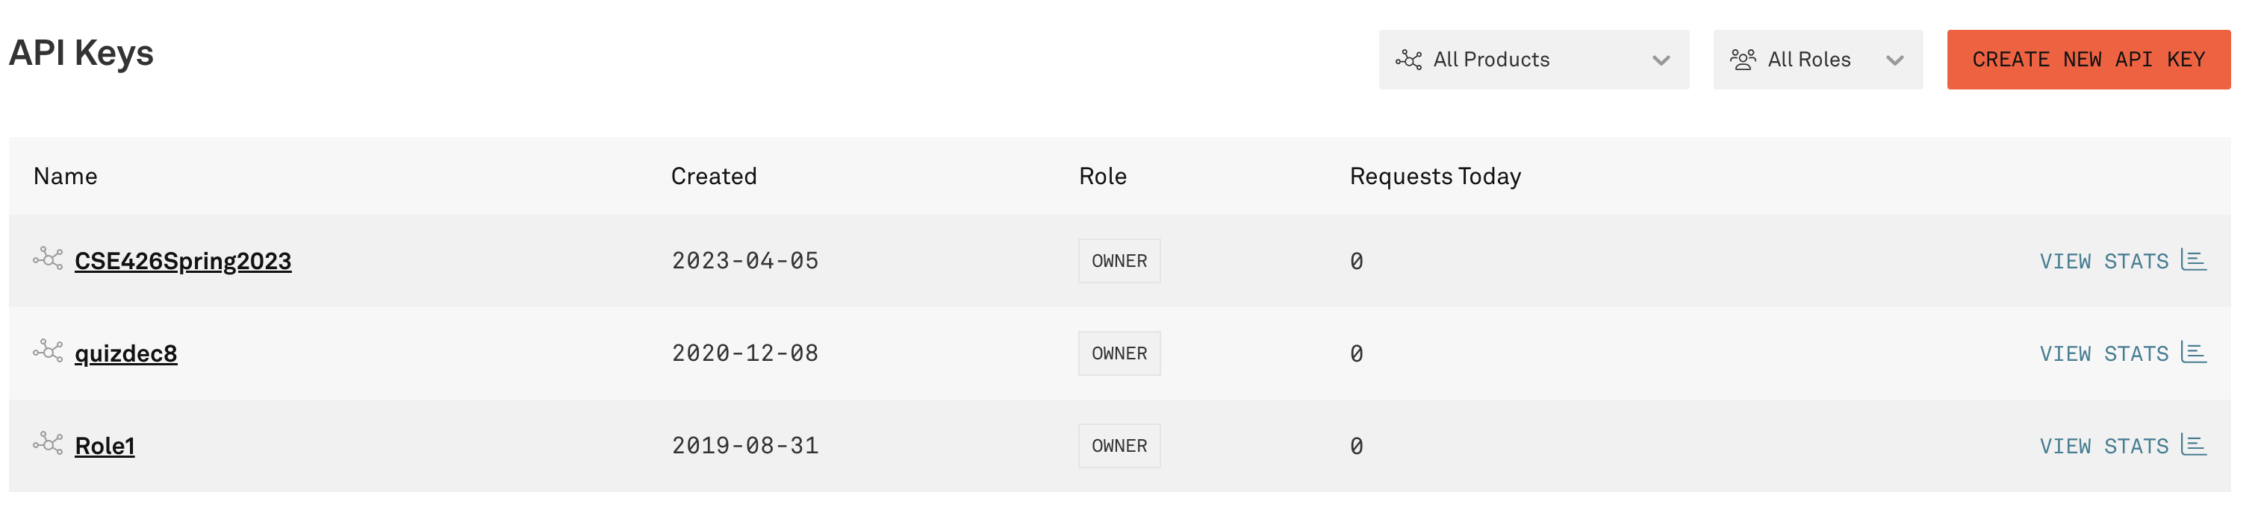

Slide 17
Naming the nodes
Even though I named the projects Role1, quizDec8, etc. to be agnostic of any particular application, each project can host multiple smart contracts.
You can deploy many smart contracts, especially related ones, in a single project of Infura, depending on the expected load.
But this assignment of role names in different projects is for convenience of interaction and testing, load balancing, and avoiding co-tenancy and separation of concerns of Dapps.
The one I used for today’s interaction is CSE426Spring2023. This can house all my smart contracts for the semester.

Slide 18
Project and Exam Material
Q
Replace Ropsten in
the book with Goerli.
This is what you’ll
do in public deployment
Today for class
activity we are going
to do step 8

Slide 19
Infura node endpoint details
You can reach this point by clicking “Settings”
and one of the node names
Keep the details secure: Do not reveal the
details.
When you click on the Project name you will
see the details of the API key and
other secure details. SO I have blacked it out.
Replace Ropsten with any of the
networks you like. What are the options?

Slide 20
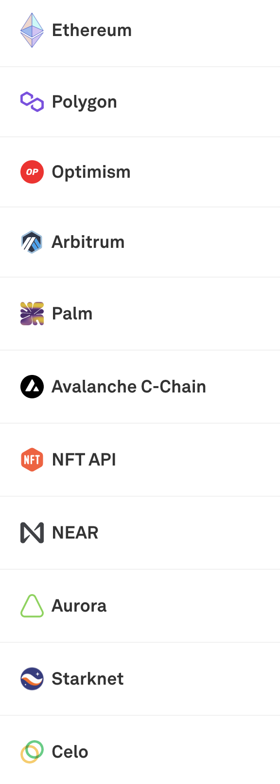
There are ones along with the test nets
that you will use.

Slide 21
An Infura node manages the blockchain gateway and infrastructure services.
But for security and privacy reasons, it does not support functions such as transaction signing and managing accounts, so you need a software module for a wallet manager.
Step 1: Installing HDWallet provider
To install the HDWalletProvider module, you’ll use the npm installer.
Add a line of code to truffle-config.js in the contract directory to install this module. This file is already included in the code we’ve provided:
const HDWalletProvider = require('truffle-hdwallet-provider');
You’ll also need a package.json
You can all these already created for you in the counter code we have provided with today’s code.
It has a README that you can use for Phase 3.

Slide 22
Configuring for smart contract deployment
Smart contracts require a node, network, account addresses, and ether balance for successful deployment.
You configure these elements by adding to the truffle-config.js (Listing 8.3)that you used for the configuration to the Ganache local chain. You need to configure these items for the smart contract deployment:
The HDWalletProvider installation specified by require('truffle-hdwallet-provider')
The mnemonic representing the deployer’s account addresses for deployment and withdrawing transaction fees
The Goerli-Infura Ethereum node endpoint address

Slide 23
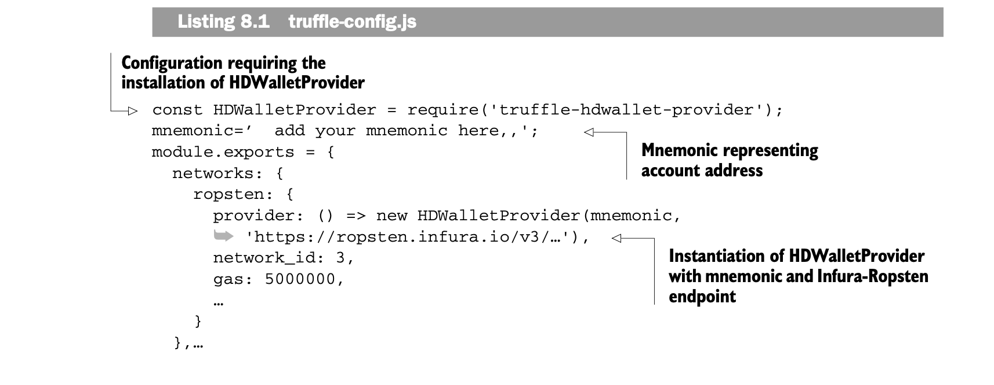
truffle-config.js
You’ll also need a package.json in your xyz-contract folder
Instead of Ropsten use Goerli.

Slide 24
const HDWalletProvider = require('truffle-hdwallet-provider');
beneficiary='';
module.exports = {
networks: {
ropsten: {
provider: () => new HDWalletProvider(beneficiary, ‘ '),
network_id: 3,
gas: 5000000,
skipDryRun: false
},
development: {
host: "localhost",
port: 7545,
network_id: "*" // Match any network id
}
},
compilers: {
solc: {
version: "0.5.8"
}
}
};
Actual truffle-config.js
For infura’s node or geth clients provided
by Infura
For Ganache or other geth clients: 5777 for ganache
Can we do this now?

Slide 25
Beneficiary details:
1. Mnemonic or seed phrase from BIP39 tool:
2. Account address Account1 on Metamask:
3. Infura project name: Role1
4. Infura end point address for Goerli:
https://goerli.infura.io/v3/6fafe598402c41c5a3c351680f6cdadc
Bidder1 Details:
1. Mnemonic or seed phrase from BIP39 tool:
2. Account address Account1 on MetaMask:
Bidder2 details:
1. Mnemonic or seed phrase from BIP39 tool:
2. Account address Account1 on MetaMask:
BlindAuction contract address after successful deploy of smart contract from Beneficiary:
0x55a84Fe65f882C609723df9fb243942F9060332C
Here are some details you may need
to run and interact with BlindAuction
On Infura. You may want to create a list for your
project to show that your project is much more than
a mere ERC721! We need some legitimate purpose
And use for you project! Do that in Phase 2.
Keccak hash values for 1, 2 and 3: for bids
1
0xeef3620c18bdc1beca6224de9c623311d384a20fc9e6e958d393e16b74214ebe
2
0x54e5698906dca642811eb2f3a357ebfdc587856bb3208f7bca6a502cadd7157a
3
0x74bbb8fdcb48d6f82df6e9067fd9633fff4cab1103f0d5cb8b4de7214cbdcea1

Slide 26
Steps in deploying on Infura
The steps are similar for your project.
1. Configure truffle-config.js to include infura and Goerli endpoint details and Your mnemonic – to charge the cost of deployment to the coinbase account generated by the mnemonic
Also include package.json to install HD wallet package
npm install
truffle migrate –network Goeri
Note the address of the smart contract when deployment on infura completes successfully
Substitute this address of SC in the app.js for the beneficiary and client: URL of infura, .json of ABI
Beneficiary: Move to BA-app; npm install; npm start
Bidders: update app.js with sc address and exact ABI ; npm install; npm start
Interact with Metamask enabled.

Slide 27
MPC application
Repeat this for MPC application
You need to update truffle-config.js with two items: infura Goerli endpoint and your mnemonic
You need to update 2_deploy_contract.js with address of worker
Deploy SC and then update app.js

Slide 28
rm –r build/
truffle migrate --network goerli

Slide 29
Counter-Dapp - Today’s Activity
Download the code from Code folder for Counter-Dapp.zip.
See the README.md file for instructions for running the counter.
But your activity for today is much simpler. I am going to /already deployed the counter smart contract on Infura-Goerli.
You are just going to interacting with by deploying the counter-app part of it (web user interface only).
Follow along the instructions given Instructions.pdf.
I will instruct you all the steps. You should have your Metamask Wallet ready on Goerli networkand with some Goerli ethers.
After interaction I want you to submit the screen of interaction showing you wallet with Goerli Tx with confirmed or pending.

